Slide 1
Recovery After disasters and individuals with disabilities what we know and what we do not
Laura M. Stough, Ph.D.
Center on Disability and Development, Texas A&M University
Amy N. Sharp, Ph.D.
Texas Center for Disability Studies, University of Texas at Austin
Elizabeth Hong
Parent Support Team, Texas Parent to Parent

Slide 2
Overview
Of the phases of the disaster cycle, the recovery phase is the longest but the least explored with respect to the experiences of people with disabilities. This session will provide an overview of what research reveals about the needs of people with disabilities and their families post-disaster. Barriers to the recovery process as well as the resource and service roles of state and local agencies, FEMA, and voluntary organizations post-disaster will be discussed.

Slide 3
Learning Objectives
Attendees will learn what research findings reveal about the needs of people with disabilities post-disaster.
Attendees will identify barriers which individuals with disabilities and their families encounter during the recovery phase of disaster.
Attendees will identify recovery services and resources typically available through various organizations post-disaster.

Slide 4
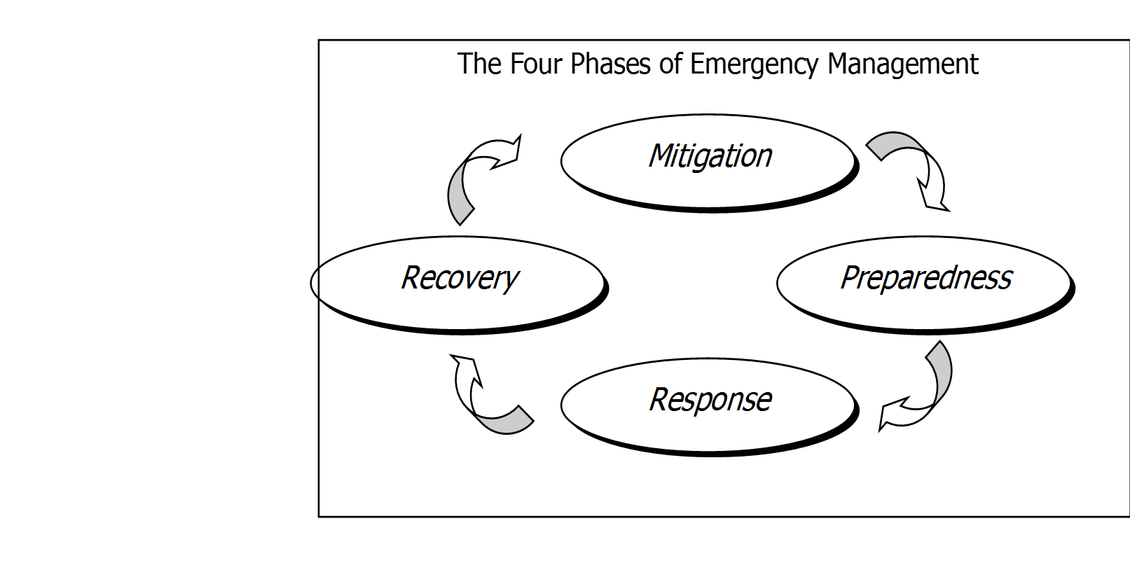
The Disaster Cycle

Slide 5
Recovery PHASE OF DISASTER
Recovery starts following the response phase.
Recovery is the phase following a disaster in which agencies and organizations help affected persons and communities to develop and implement plans and structures for return to pre-disaster functioning.
The recovery phase is typically the longest phase of disaster and can last for an extended period of time- even several years.

Slide 6
Recovery PHASE OF DISASTER
Typical activities include restoration of infrastructure and vital support systems, resumption of the routines of daily life, and initiation of plans for permanent housing.
Human, material, and financial resources may dwindle, along with decreasing public attention.

Slide 7
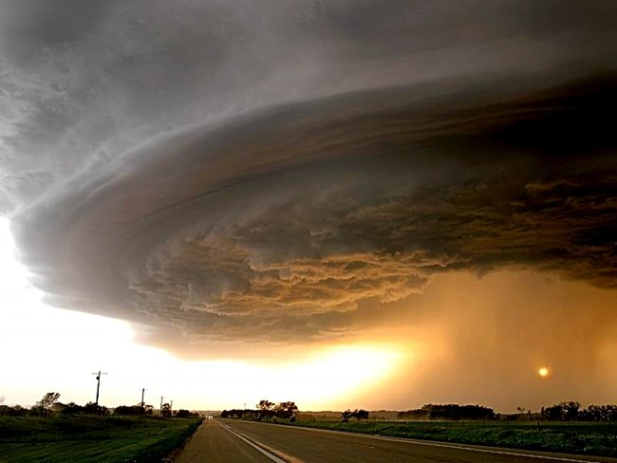
Research Indicates People with Disabilities Experiencing Disaster:
Die at a higher rate
Often lose their homes or have high property damage
Are more likely to incur injuries
Experience health-related complications
Receive less assistance from emergency personnel and volunteers
Take longer to recover
(Stough, & Kelman, 2018).
Image of a storm cloud.

Slide 8
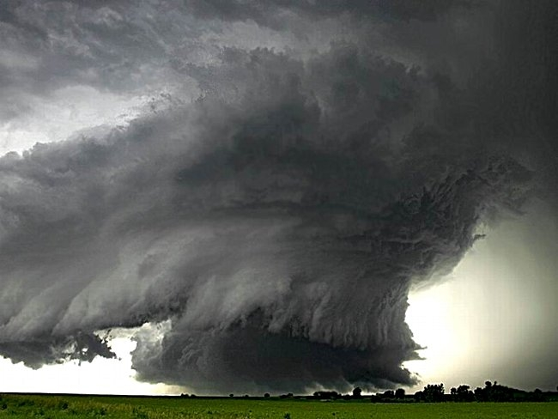
Pre-disaster, people with disabilities are more likely to:
Live in poverty
Be unemployed
Live in a flood plain
Have limited access to healthcare
Have smaller social networks
(Stough & Kelman, 2018)
Image of a funnel cloud.

Slide 9
Disproportionate impact
Disasters do NOT impact everyone equally
It is not only that people with disabilities are more likely to be impacted, it is that the loss and severity of the impact is disproportionate.
These families thus begin the recovery phrase two steps behind, rather than one step behind.
These factors make recovery even more complicated post-disaster

Slide 10
Disaster case management
Case managers are active during the response and recovery phases.
Used to connect disaster survivors to needed resources and services.
Case managers are typically assigned to an individual or family.
The case manager meets with clients to determine their current needs and to collaboratively agree on goals.
The case manager informs clients about resources that might meet their needs and the programs for which they meet eligibility.
Identify documentation needed to apply for assistance and guides the client in completing applications.

Slide 11
Disaster Case Management
People with disabilities and other functional and access needs typically need more intensive disaster case management
Disaster recovery for individuals with disabilities can be strengthened through:
Connection with disability-related resources
Direct advocacy by the case manager
Collaboration with other agencies
Client motivation and persistence
(Stough, Sharp, Decker, & Wilker, 2010)

Slide 12
Barriers to recovery
People with disabilities encounter most of the same types of barriers to recovery=
Housing, transportation, financial support, furnishing
However, there are two systems to negotiate=
Disability support system: personal assistants, special education services, medical supports
Disaster support system: temporary housing, financial assistance, food, clothing
Paperwork and negotiating these two systems
(Stough, Sharp, Resch, Decker, & Wilker, 2017)

Slide 13
The Spoon theory
Each activity of living requires mental and physical energy (a spoon)
When you/your child have a disability it takes a LOT of spoons
We manage through
Natural support
Formal Supports
Services
Notes:
All individuals have a limit to how much they can accomplish in a day. Christine Miserandino (a person with lupus) used the Spoon Theory to visually show how individuals with a disability and their families often use most of their “spoons” to accomplish life tasks and can run out of spoons or capacity to complete necessary tasks
Parents new to disability are in survival mode and struggling because they do not have supports and use up all of their spoons just getting the bare minimum done
We develop natural supports like family members, church groups, friends/social groups who can help by providing their “spoons” through providing transportation, respite, and help with tasks
When we have natural and formal supports and services, we can settle in and experience less stress
Formal supports and services like personal care services, public transportation, case managers, and other professionals can also help share the load that individuals with a disability and their families are carrying.

Slide 14
After a Disaster
May lose our support network
Displacement has major implications
Jump through hoops again
Replace specialized items
Notes:
Individuals with a disability and their family members heavily rely on support networks. After a disaster our support systems may also be experience challenges or displacement and may not be able to provide the support they once provided, leaving us to again use all of ours spoons at a time when our needs have increased.
Also, displacement has major implications for individuals with a disability and their families. This can affect available insurance, services, and providers. Setting up new services and getting new providers often means that families will have to jump through hoops that they have already jumped through so that they can start these same services anew.
Families often have invested money into tools, items, and aides that help the individual with a disability to be an independent as possible or to help increase their quality of life. These items are not always covered by insurance and include things like fidgets, sensory items, specialized shoes or clothing, medical equipment not deemed medically necessary by the insurance are all items that may be lost during a disaster and add cost and time for families. Even recovering durable medical equipment that is covered can take time and use up a LOT of spoons (phone calls, forms, etc.). For example, wheelchairs are often designed specifically for the individual using it and accommodate specific needs for that person’s body, forming to them to make them comfortable. One DME company was quoting a month wait for a replacement for wheelchairs lost during Harvey. If they were getting them done this fast, is incredibly fast turn around (usually takes 6 months give or take) but without an appropriate wheelchair that meets the requirements this can leave the person uncomfortable, in pain, having spasms, and without a viable method of transportation within their community as specialized wheelchairs are often required for transportation in a vehicle.
The losses experience by an individual with a disability can have such big repercussions and trickle down into all aspects of that individual’s life

Slide 15
The interplay of needs
Housing
Employment
Transportation
Health
Notes:
After a disaster, individuals with a disability and their families, may have to put their energy (spoons) into first addressing important needs. This may mean replacing lost medication, life saving medical equipment, etc. Addressing these needs are vitally important and may take precedence over other needs like employment or finding permanent housing. This may mean that they get a late start in the game.
After a disaster, an individual with an accessibility need may have trouble finding appropriate housing
After Houston when the housing market was stressed, one family someone had helped them find an apartment but it was up a flight of stairs, they struggled to find a first floor or elevator accessible apartment and had to move farther out in their city to find an apartment that met their needs. Her child had to go to a new school (which means new ARD/IEP meeting) and this longer distance that she had to travel for work created a strain on her childcare system, herself, and her child.
Individuals with disabilities and their families may also be personally moving away from the supports that allow them to thrive and live independently in their communities
Housing can also affect a family’s medical system. Your private insurance does not care where you live. While it may affect the providers you have available, you are not required to contact them or switch companies. With Medicaid, displacement means you must contact HHSC, SSI, Medicaid, etc.
Local authority services (whether for IDD or mental health) require an intake before setting up appointments and receiving services. This means that families must start from the beginning when they relocate.
Switching regions in Texas may mean switching Medicaid managed care organizations
Switching locations or insurance providers may mean finding new specialists, referrals, transferring medical records, new intake, prescription issues
These barriers can take hours to manage and handle. It also takes away spoons from the family and interfere with their ability to put energy into finding housing, employment, etc that they to get back onto their feet
Transportation issues can also affect the ability for the individual and their family’s ability to access new specialists and providers
Transportation has major implications for all aspects of a person’s life. Including housing, employment, education, medical needs and social needs as well.
Families who have a vehicle for transporting their child often have large loans and have used large portions of their Medicaid waiver budgets to finance these vehicles which take months to get modified.
Certain transportation programs may only be available in urban centers or parts of the city that house the most people and may also be experiencing a crunch
Companies like Uber have a limited number of vehicles that are able to provide accessible transportation. Drivers may not be willing to drive to more rural areas.
During the recovery period, your support networks may be stretched too thin to be available to provide transportation
Often for individuals with a disability we look to build a job around the individual to help mitigate barriers to employment that exist even before a disaster has occurred. This often includes planning, personal investment, networking and connections with friends and families. After a disaster families may need to begin this process anew. May not be prioritized during recovery when there are bigger problems to solve.
Families may struggle to regain employment if they do not have childcare that can provide for their child’s medical, physical, emotional, and other needs.
For example, in one family Dad lost his job during Harvey. To help make ends meet, mom (who previously provided care for their 15 year old child with a disability) got a job as a home health aid. This did not provide enough income for their family. When Dad was able to get work mom would have to stay home from her job to provide care. But Dad was only able to find temporary employment so the family was in a constant state of juggling and barely able to make ends meet.

Slide 16
Resources for Long term recovery

Slide 17
Who you are matters
Long Term Recovery Looks Differently for Different Populations…
*https://factfinder.census.gov/faces/tableservices/jsf/pages/productview.xhtml?pid=ACS_17_5YR_DP05&src=pt
**https://factfinder.census.gov/faces/tableservices/jsf/pages/productview.xhtml?pid=ACS_17_5YR_DP02&prodType=table
*** https://factfinder.census.gov/faces/tableservices/jsf/pages/productview.xhtml?src=CF
****Centers for Disease Control and Prevention
Population | % of US
Low socio-economic status*** | 10.5%
Elderly – age 65+* | 14.9%
People with disabilities**** | 22.0%
Language other than English** | 21.3%
Notes:
The elderly and PWD may be less tech savvy. Those with low SES may have less tech access. Technology is how most resources are found…. 10.5% have no health coverage.
For at-risk populations LTR takes even longer, if it ever occurs.
How can your community be prepared to support long-term recovery?

Slide 18
Know who does what….
Federal Emergency Management Agency (FEMA)
State and Local Agencies
Voluntary Organizations Active in Disasters (VOAD)
Notes:
There are three primary support levels hat are typically present during the long term recovery period.
FEMA – immediate and long term needs however they focus primarily on housing
State/Local – variable supports provided. Esp once the disaster news cycle is over the communities are still in need, they still need access to supports and resourecs and services.
VOADS - coalition of organizations that prepare for and respond to the recovery needs of America’s communities in times of disasters

Slide 19
FEMA
Disaster assistance may include
grants to help pay for temporary housing,
emergency home repairs,
uninsured and underinsured personal property losses and medical,
dental and funeral expenses caused by the disaster, along with other serious disaster-related expenses.
https://www.fema.gov/news-release/2016/01/28/commonly-asked-questions-about-federal-disaster-aid

Slide 20
FEMA
Provides grants to qualified homeowners to repair damage not covered by insurance; renters may qualify.
Personal property, vehicle repair or replacement, and moving and storage expenses is income-dependent and officials make decisions on a case-by-case basis.
www.DisasterAssistance.gov
https://www.fema.gov/news-release/2016/01/28/commonly-asked-questions-about-federal-disaster-aid

Slide 21
Small Business Administration
The SBA provide financial assistance through FEMA following a disaster and provides low-interest disaster loans to homeowners and renters.
Loans to cover repairs and replacement of physical assets damaged in a declared disaster.
Loans to cover small business operating expenses after a declared disaster.
Notes:
Note these are loans and not grants

Slide 22
Long-term recovery committees
Strengthens area-wide disaster coordination by sharing information, simplifying client access and jointly resolving cases with unmet needs;
Helps affected families to develop a plan and receive adequate assistance for the recovery;
Composed of representatives from disaster response agencies; and
Notes:
The strength of the LTRC is that they are part of the local and state community, have the ability to reach its members and listen to the specific needs of the community.
They then work with VOADS and local agencies to meet the identified needs. Often the LTRC find the people who have become lost among the overlapping systems delivering assistance to survivors of the disaster.
One of the key elements in the committee's work is knowledge of survivors' needs.
DELAWARE - local flood survivor lost her entire collection of cookbooks. This posed a real problem because the survivor is a cookbook editor, and the loss threatened her livelihood. The committee's co-facilitator, was able to network with a local chefs organization to get the editor copies of many of the cookbooks, starting her back on the road to recovery.

Slide 23
LTRC…..
Composed of non-profit volunteer, civic, faith-based, and other state and local organizations in local counties.
Exists with all participating organizations as equal partners.
Notes:
These are not typically listed in the phone book – it often takes some time to find them.
Identify who/where they are before the disaster!

Slide 24
Other State and Local Resources
Centers for Independent Living
Protection & Advocacy Centers
University Centers on Developmental Disabilities
Paratransit systems
Schools
Libraries
Lion’s Clubs, Rotary, Meals on Wheels, United Way, Easter Seals… just to name a few
Notes:
Every community has their own eco-system. Think about the orgs/agencies that are active in your area and contact them ahead of time to ask if they are active in disasters, what they do, who they serve, etc.

Slide 25
Voluntary organizations active in disaster (VOADs)
A coalition of organizations that prepare for and respond to the recovery needs of America’s communities in times of disasters.
50+ reputable NGOs
Over 40 years of experience in disaster support
Find your state VOAD Chair- https://www.nvoad.org/
Notes:
Many member orgs are faith-based however during VOAD service they do do proselytize. Habitat, Humane Society, Red Cross…

Slide 26
SUPPORT SYSTEMS POST DISASTER
Social relationships provide emotional and instrumental support post-disaster
However, social support systems may have changed due to:
Displacement of the individual,
Neighbors, or community members displaced or moved,
Communities and buildings needing to rebuild (e.g. community centers, libraries).
Number of social support systems may have changed.

Slide 27
REDDy Directory
REDDy: REsources on Disasters and Disability
The REDDy Directory is a project jointly funded by the Association of University Centers on Disability and the Administration on Intellectual and Developmental Disabilities.
Based on a database of 2500+ disability resources
Notes:
A response to Hurricane Harvey.
Documents recovery resources for individuals with disabilities.
SUB DIRECTORY of an existing directory
Dynamic online resource directory of services and resources.
IMMEDIATE PURPOSE - To provide a searchable resource guide
For disability-related organizations, and
To document supplies and resources for individuals with disabilities who were affected by disaster.
AND
FUTURE - Develop an online, replicable template for
A variety of disasters, and
Transferable to other regions.

Slide 28
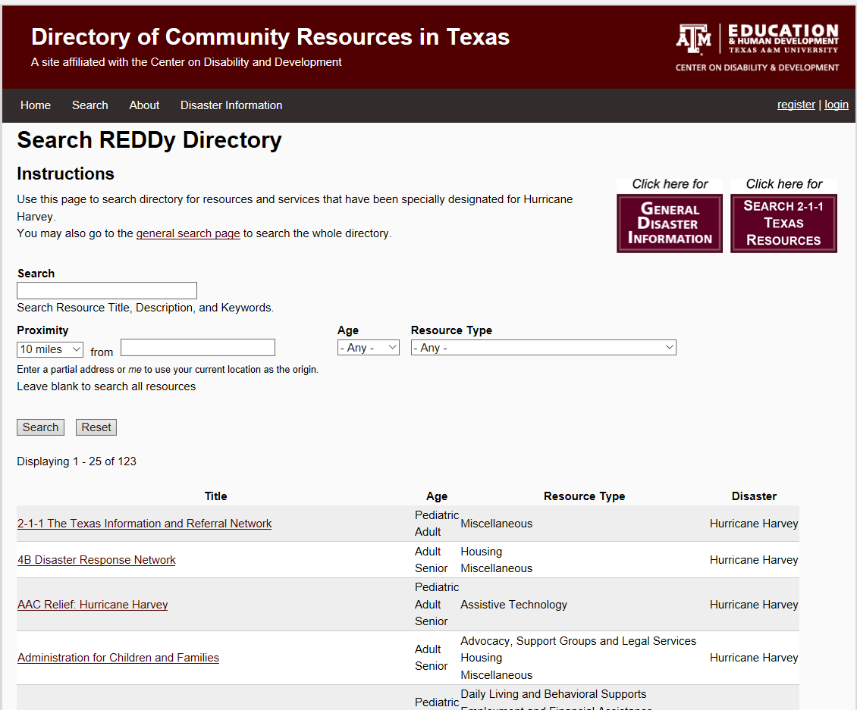
Graphic of the REDDy Interface with functions labeled.
Links to 2-1-1 and Project REDD General Disaster Information.
Search by Resource Title, Description, Keyword or Location.
Search by Age Group (Adult, Senior, Pediatric) or Resource Type.
Listed Resources/
Services. More details when selected.
Notes:
Case workers
Long-term recovery committee
Voluntary Organizations Active in Disasters (VOADs)
City and county emergency managers
Disability organizations
Individuals with disabilities
Disaster organizations

Slide 29
Supporting Individuals with Disabilities Recovering from Hurricane Harvey

Slide 30
ContactS
Laura Stough lstough@tamu.edu
Amy Sharp sharpamy@utexas.edu
Liz Hong elizabeth.hong@txp2p.org

